Slide 1
CAH-QKD: Context-Adaptive Hybrid Quantum Key Distribution with Machine Learning-Based Protocol Selection
By- Aayush K. thorat
Div – Be 5
Batch – s5
Roll No. 42475
Exam Seat No. B400050291

Slide 2
Problem Statement
Goal:
  Predict (1) Secure Key Rate (SKR) and (2) Transmission efficiency for a given setup
Why it matters:
  QKD protocol choice depends on hardware + distance + environmental noise
Output shown to user:
  Top-3 protocols ranked by predicted SKR

Slide 3
What the Model Learns (Inputs → Outputs)
Inputs (4 features):
  protocol (categorical, label-encoded)
  platform / architecture (categorical, label-encoded)
  distance_km (scaled)
  noise_factor (scaled)
Outputs (2 regression targets):
  secure_key_rate (0–1, higher is better)
  transmission (0–1, channel efficiency)
Multi-output regression:
  one model predicts both outputs together

Slide 4
Data Sources & Coverage
Training data: multiple CSV datasets (one or more per protocol family)
Protocols supported (10):
  AB-QKD, B92, BB84, BBM92, DS6-QKD, Decoy-BB84, E91, EEPM-QKD, SARG04, Six-State
Architectures supported (4):
  ionq_aria, ionq_harmony, rigetti_aspen_m3, oqc_lucy
Dataset size (from saved stats):
  Total samples = 40,000
Observed ranges:
  Distance range: 5.0–250.0 km
  Noise range: 1.0–2.5
  Secure key rate range: 0.0–0.5713
  transmission range: 0.00001–0.7943

Slide 5
Preprocessing Pipeline
Load all CSVs from data/ using required columns:
  [protocol, platform, distance_km, noise_factor, secure_key_rate, transmission]
Cleaning:
  drop missing values
  filter negative SKR (invalid)
  remove extreme outliers (> 3σ) on distance, noise, and SKR
Encoding:
  LabelEncoder for protocols → protocol_encoded
  LabelEncoder for platforms → platform_encoded
Scaling:
  StandardScaler on distance_km and noise_factor
Saved artifacts to result/:
label_encoder.pkl, platform_encoder.pkl, scaler.pkl, data_stats.pkl

Slide 6
Deep Learning Architecture
Model type: Fully-connected feed-forward neural network (MLP) for tabular data
Input vector (shape = 4): [protocol_encoded, platform_encoded, distance_scaled, noise_scaled]
Hidden layers (ReLU): 128 → 64 → 32 → 16
Regularization for stability/generalization:
  L2 weight decay on first layers (l2 = 0.001)
  Batch Normalization after dense layers
  Dropout: 0.2, 0.2, 0.1
Output layer: Dense(2) with linear activation (SKR, transmission)

Slide 7
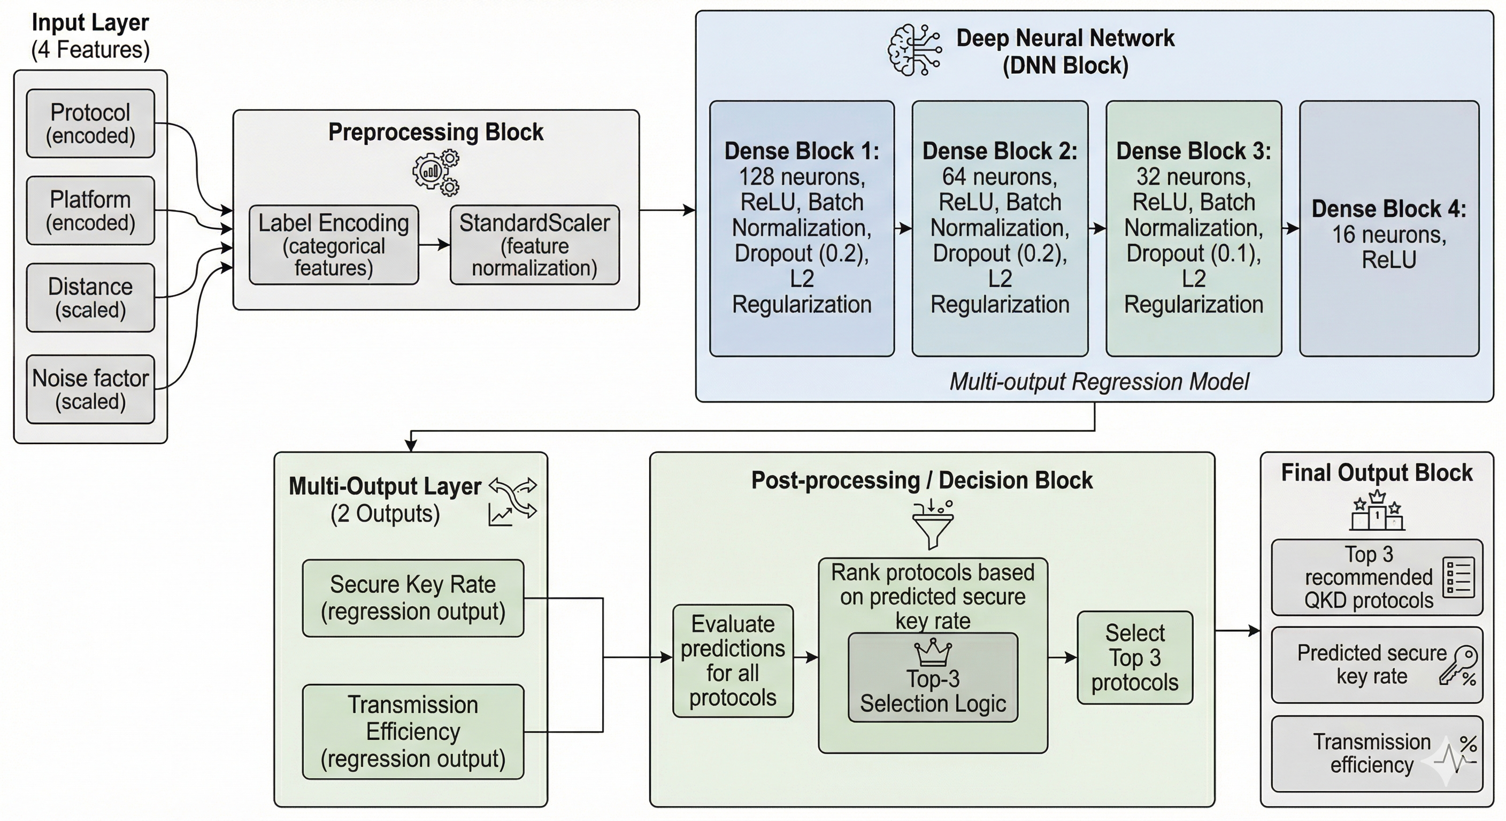
Model Architecture diagram

Slide 8
Training Setup
Optimizer: Adam (learning_rate = 0.001)
Loss: Mean Squared Error (MSE)
Metrics tracked: MAE, MSE (plus custom evaluation metrics after training)
Hyperparameters (saved):
  epochs = 200, batch_size = 32
  validation_split = 0.2 (from training set)
  test_size = 0.2 (held-out test)
Reproducibility:
  seed (meaning): a fixed starting value for a pseudo-random number generator so “random” steps repeat.
  NumPy seed = 42: makes NumPy-based randomness repeatable (e.g., shuffling/sampling/splits).
  TensorFlow seed = 42 (when TF available): makes TF/Keras randomness more repeatable (e.g., weight init/dropout).

Slide 9
Training “Safety Nets” (Callbacks)
EarlyStopping:
  monitor = val_loss
  patience = 20
  restore_best_weights = True
ReduceLROnPlateau:
  monitor = val_loss
  factor = 0.5, patience = 10
  min_lr = 1e-6
ModelCheckpoint:
  saves best model by val_loss → result/best_model.keras
Quick definitions (Slide 7 terms):
Callback: a training “hook” that runs automatically during training (e.g., end of each epoch) to control learning.
monitor: which metric we watch to decide when to stop / reduce LR / save the model.
val_loss: loss computed on the validation set (unseen during weight updates); used as a proxy for generalization.
patience: number of epochs to wait without improvement before triggering an action.
restore_best_weights: after stopping, reload the weights from the epoch with the best monitored metric.
ReduceLROnPlateau: lowers the learning rate when progress stalls (helps fine-tune toward a better minimum).
factor: multiplier applied to the learning rate when reducing it (new_lr = lr × factor).
min_lr: lower bound so learning rate doesn’t become too small.
ModelCheckpoint: saves a snapshot of the best model so we can deploy the best-performing version.
Key benefit: avoids overfitting + stabilizes convergence on noisy simulated data

Slide 10
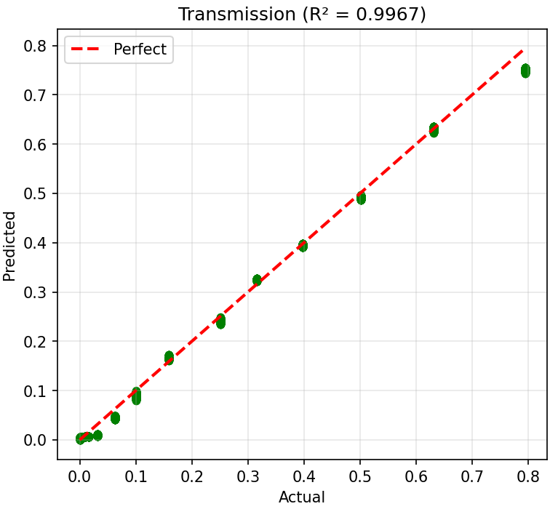
Performance
Secure Key Rate (SKR):
  R² = 0.9320
  MAE = 0.0269
Transmission:
  R² = 0.9918
  MAE = 0.0133
Overall (average across outputs):
  R² = 0.9619 (meets >0.90 target)
  MAE = 0.0201

Slide 11
Inference & Protocol Recommendation
For a given (architecture, distance, noise):
  loop over all 10 protocols
  preprocess each candidate input with the SAME saved encoders/scaler
  predict (SKR, transmission)
  rank protocols by predicted SKR (descending)
User-facing result:
  Top-3 recommended protocols + full comparison table

Slide 12
THANK YOU

